Slide 1
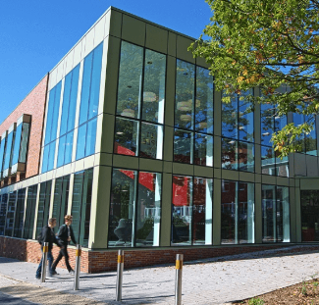
Welcome!

Slide 2
Safeguarding and Wellbeing at Oaklands
We have a dedicated team of safeguarding officers who can support students across both St Albans and Welwyn Garden City college campuses.
We offer students a safe space to talk on a 1:1 basis with one of the team who provide advice and support based on your support needs as a student.

Slide 3
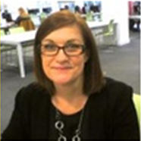
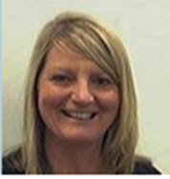
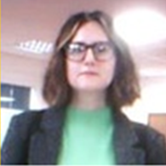
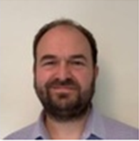
Meet the Team
Sara Davison
Emily Slater
14-16 Coordinator & Designated Teacher Care Leavers and Looked after children
Safeguarding and Wellbeing Manager
Eve Dulcie Telsa
Beth Karolina Paul
Welwyn Garden City Advisors
St Albans Campus Advisors

Slide 4
How we can support
We are here to help Students with:
Accessing college bursary fund
Mental Health and Wellbeing support
Safeguarding students

Slide 5
College Bursary Fund
What the bursary fund can provide support with:
College meals
Travel
Kits, books and essential course equipment
Childcare whilst you are studying at college
What makes you eligible to apply?
Anyone aged 16 or above up can apply
Evidence of financial need not being met
Household Income must be below £29,250 annually – this includes salaries and benefits received from anyone aged 18 or above who lives with the student, including your income as a student if you receive benefits or have a part time job.
No automatic entitlement to bursary based on individual circumstances i.e. registered disability, registered care status or being in receipt of specific benefits.

Slide 6
College Expectations
The College is determined to provide a safe, respectful and caring environment where any form of bullying or harassment is not tolerated, differences are celebrated and all students feel valued and treated with dignity and respect.
The College will take all allegations seriously and provide support to any student who feels they are being bullied or harassed.

Slide 7
Issues we can help with…
Online Threats & Malicious Communication | Peer on Peer Abuse | Drug or Alcohol Use | Mental Health and Wellbeing
Anxiety | Counselling Referrals | Exploitation | Sexual Harassment or Abuse
Homelessness | Self Harming Thoughts | Free Sanitary Products | Risk of Criminal Involvement
Risk of Radicalisation | Relationship Issues and Domestic abuse | Sexual Health Referrals | Bereavement

Slide 8
What does Safeguarding Support look like
The Safeguarding team are here to:
Respond to referrals made by college staff or students to advise on support available
Support you to feel respected and safe
Support and advise you if you are concerned about a friend
Provide you with support, advice and guidance on a range of services who can provide support based on your needs or wishes.
Respond to any student disclosure of abuse or harassment seriously.
Liaise with external agencies and make referrals to external agencies for student support when needed.

Slide 9
What your curriculum team can support with
Conflict or resolution with other students in your class or course
Behaviour or inappropriate conduct
Worries or queries around your study programme
Refer to the safeguarding and wellbeing team if students require additional
Learning Mentors - Your class will be supported by a Learning Mentor who will provide information on, and guide discussion around, a range of important social and personal development themes. Your Learning Mentor will also be available to offer one-to-one support to you and can signpost you to other teams and services within the college for additional help.

Slide 10
Referrals and Additional Support
The safeguarding and wellbeing team signpost and refer you to specialised support services based on your individual circumstances
Housing Services and Charities | Beacon (Victim Support) | Youth Talk (free counselling) | NHS 111 | Citizen Advice Bureau (CAB) | Police 101 & 999
Drug & Alcohol Services | Just Talk & Mind | NHS Mental Health Services | Brook | Samaritans | Terrance Higgins Trust
College Counsellor | Adult Social Care | Safer Places & National DV Helplines | Herts Young Homeless (HYH) | Services for Young People (Youth Connexions) | Crime stoppers & Fearless
Foodbank & Hygiene Banks | YMCA | GP and A&E | Wellbeing Service

Slide 11
College Counsellor and Wellbeing Support
Oaklands College provide an external counsellor based at the St Albans and Welwyn Garden City campuses 3 days per week who can provide 6-10 structured counselling sessions for students if deemed appropriate.
The college has an NHS Educational Mental Health Practitioner who provides support around low level mental health needs i.e. depression, self-esteem and anxiety (if you are studying at the St Albans Campus).
Talk to the safeguarding team if you feel you would like to explore either these options

Slide 13
Where can you find the team?
Come and Visit us in the Careers and Advice Hub on either campus
Welwyn Garden City Campus – opposite the sports hall and up the small set of stairs
St Albans Campus – next to the LRC and opposite the canteen
Alternatively you can contact us by:
Phone the safeguarding team on 01727 735717
Email for wellbeing or safeguarding support: safe@oaklands.ac.uk
Email for Bursary information: bursary@Oaklands.ac.uk

